Slide 1
CIS395 Project Homework 1
Create UML Entity Diagrams from the Data Gathering Forms (6 forms)
DreamHome Database Project
Use umletino and save your UML entity diagram as modifiable uxf file.
Upload the uxf file to Blackboard assignment space.
http://www.umletino.com/umletino.html

Slide 2
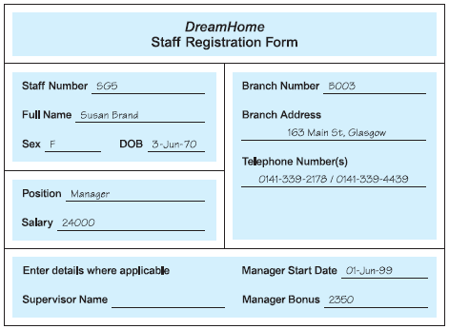
Using Fact-Finding Techniques – A Worked Example

Slide 3
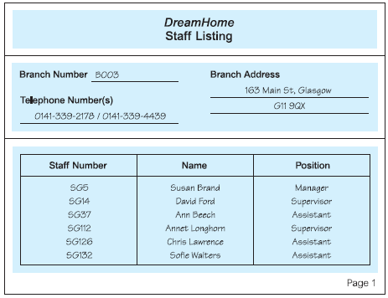
Using Fact-Finding Techniques – A Worked Example

Slide 4
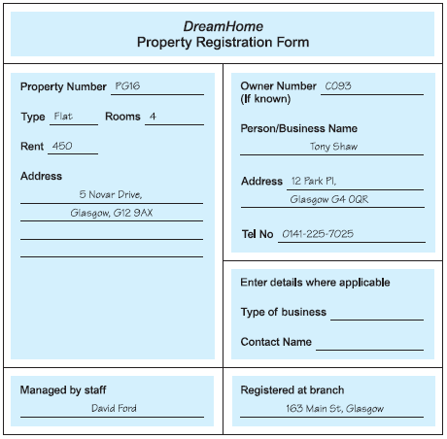
Using Fact-Finding Techniques – A Worked Example

Slide 5
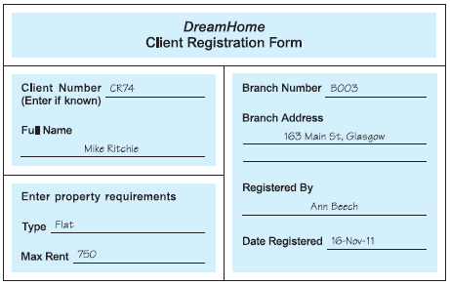
Using Fact-Finding Techniques – A Worked Example

Slide 6
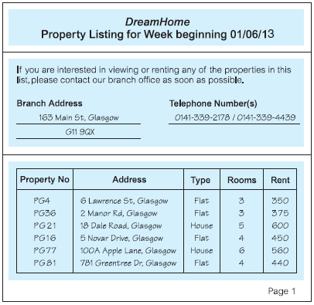
Using Fact-Finding Techniques – A Worked Example

Slide 7
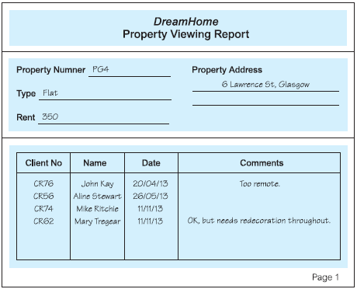
Using Fact-Finding Techniques – A Worked Example

Slide 8
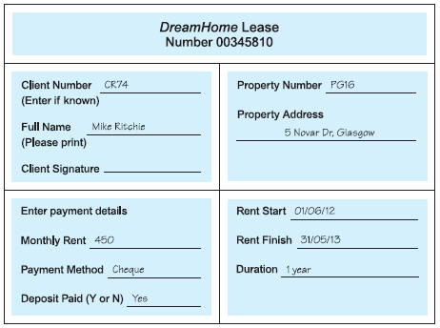
Using Fact-Finding Techniques – A Worked Example

